Slide 1
MOBILE INN BY Syed Mrawet & M Zakaullah Safdar

Slide 2
about our website
target audience
future of our website

Slide 3
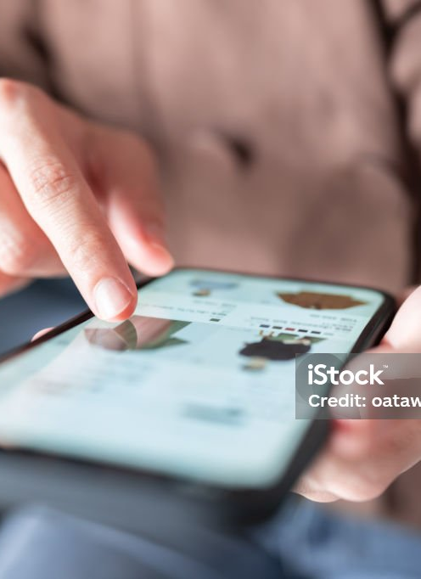
About our website:
Overview of the Mobile Phone Industry: Provide a brief overview of the mobile phone industry, including key players, market trends, and consumer preferences. Highlight the growth of online mobile phone sales and the increasing importance of e-commerce in this sector.
Advantages of Buying Mobile Phones Online: Discuss the benefits of purchasing mobile phones online, such as convenience, wider product selection, competitive pricing, and access to customer reviews and ratings.
Product Range and Brands: Describe the range of mobile phones available on your website, including popular brands, latest models, and special features. Highlight any exclusive deals or offers that set your store apart from competitors.
Secure Shopping Experience: Assure customers of a safe and secure shopping experience on your website. Mention the use of encryption technology for secure transactions and the protection of customer data.
Mobile App: If applicable, mention the availability of a mobile app for convenient shopping on smartphones and tablets. Highlight the features and benefits of using the app for a seamless shopping experience.

Slide 4
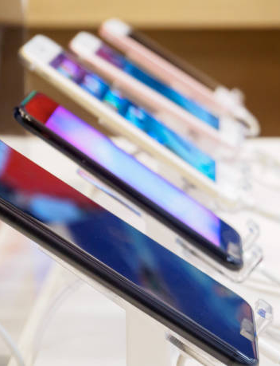
TARGETED AUDIENCE Gamers and Entertainment Seekers: Highlight mobile phones with high-performance specifications that cater to gamers and entertainment seekers. Emphasize features like high refresh rate displays, powerful processors, and immersive audio capabilities. Budget-Conscious Consumers: Offer a range of mobile phones at different price points to cater to budget-conscious consumers. Highlight value for money and cost-effective options that meet their needs without breaking the bank. Fashion and Style Conscious: Target individuals who view mobile phones as a fashion statement. Highlight stylish design elements, trendy colors, and sleek form factors that appeal to this audience. Students and Young Professionals: Cater to students and young professionals who rely heavily on mobile phones for studying, work, and socializing. Highlight features like long battery life, fast performance, and compatibility with productivity apps. Customer Service and Support: Provide excellent customer service and support to build trust and loyalty among your target audience. Offer easy returns, warranty options, and responsive customer support channels to address any issues or concerns

Slide 5
Future of our website:
Technological Advancements: Continued advancements in technology, such as AI and machine learning, will further personalize the online shopping experience. This includes personalized product recommendations based on past purchases, as well as the integration of virtual assistants for voice-activated shopping.
Expansion of Delivery Options: The demand for faster and more flexible delivery options will continue to grow. Same-day and even within-the-hour delivery services will become more common, especially in densely populated urban areas.
Integration of Augmented Reality (AR) and Virtual Reality (VR): AR and VR technologies will play a significant role in enhancing the online grocery shopping experience. Customers may be able to virtually "walk through" aisles, examine products up close, and even visualize how certain items will look or fit in their homes.
Focus on Sustainability: Consumers are increasingly concerned about the environmental impact of their purchases. Online grocery retailers will need to prioritize sustainability initiatives, such as reducing packaging waste, offering eco-friendly product options, and implementing more efficient delivery logistics to minimize carbon emissions.
Expansion of Click-and-Collect Services: Click-and-collect services, where customers order online and pick up their groceries at a designated location, will continue to gain popularity. This option provides convenience for customers who prefer to avoid delivery fees or have tight schedules.

Slide 6
Website idea and planning
contacts:
SYED MRAWET
03016598170
M ZAKAULLAH
03270583488

